Slide 1
MITRE Web Form CVE Entry Submission Process
CVE Team

Slide 2
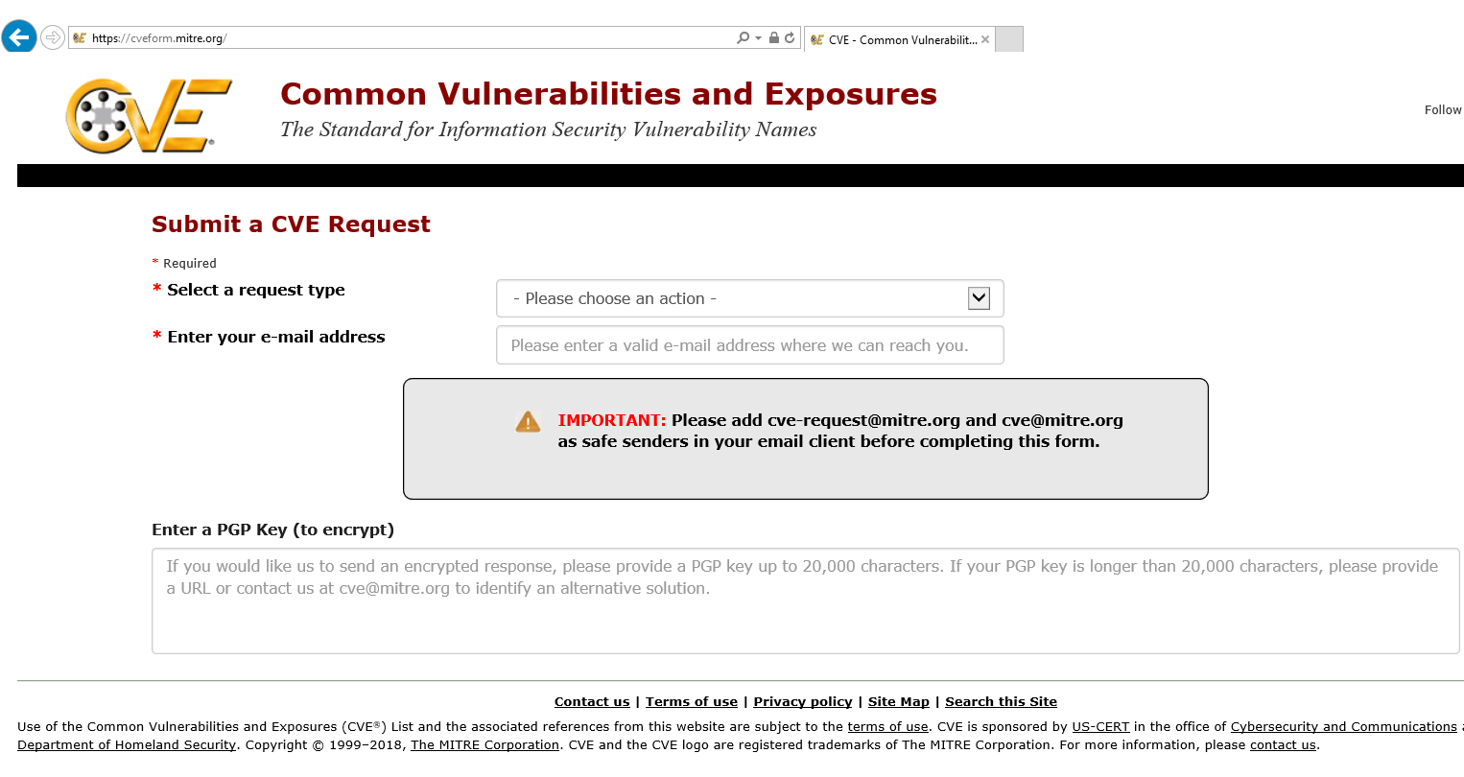
Go to https://cveform.mitre.org/

Slide 3
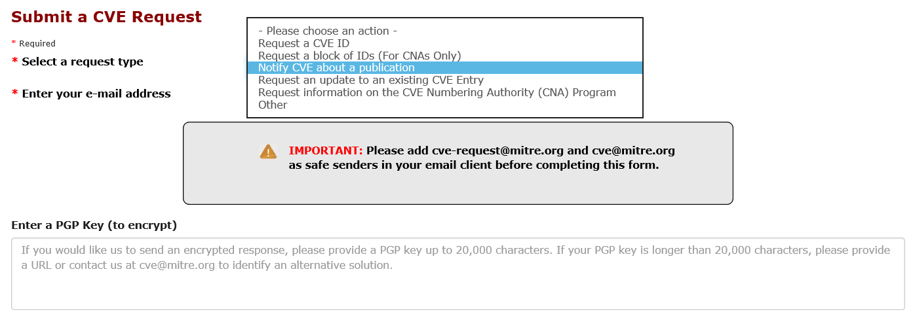
Select the “Notify CVE about a publication” request type

Slide 4
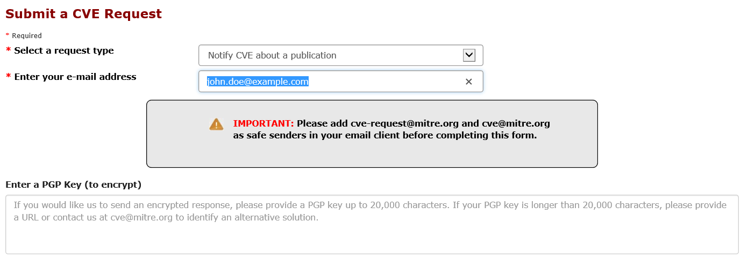
Fill in Contact Information

Slide 5
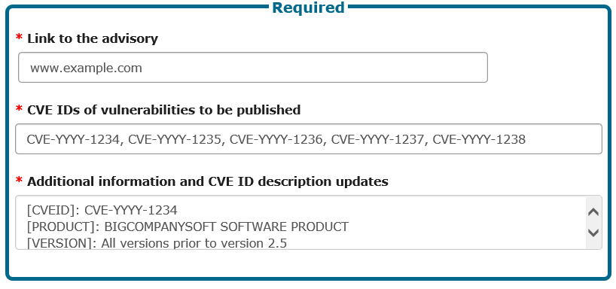
Fill in the Submission Information
Instructions for submissions greater than 2000 characters in size are at the end of the slides.

Slide 6
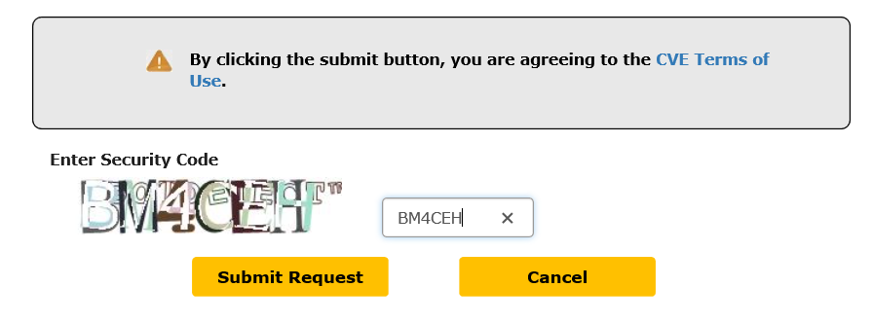
Fill in the Captcha and Select the Submit Request Button

Slide 7
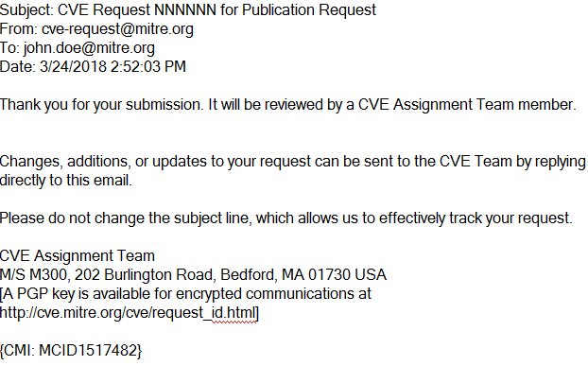
A Ticket will be Created and Email Acknowledging Sent

Slide 8
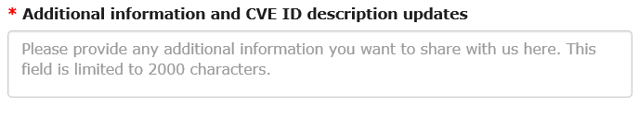
The Description Field is Character Limited

Slide 9
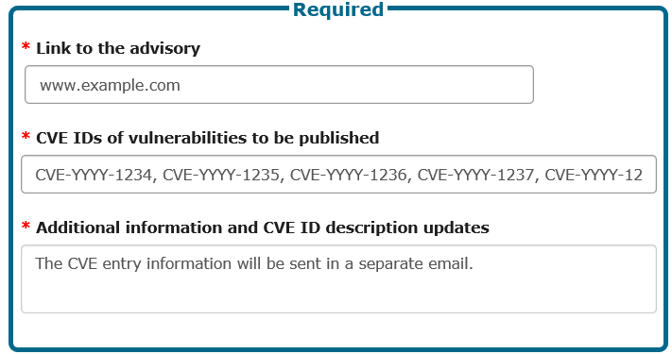
If you need more characters, use email …

Slide 10
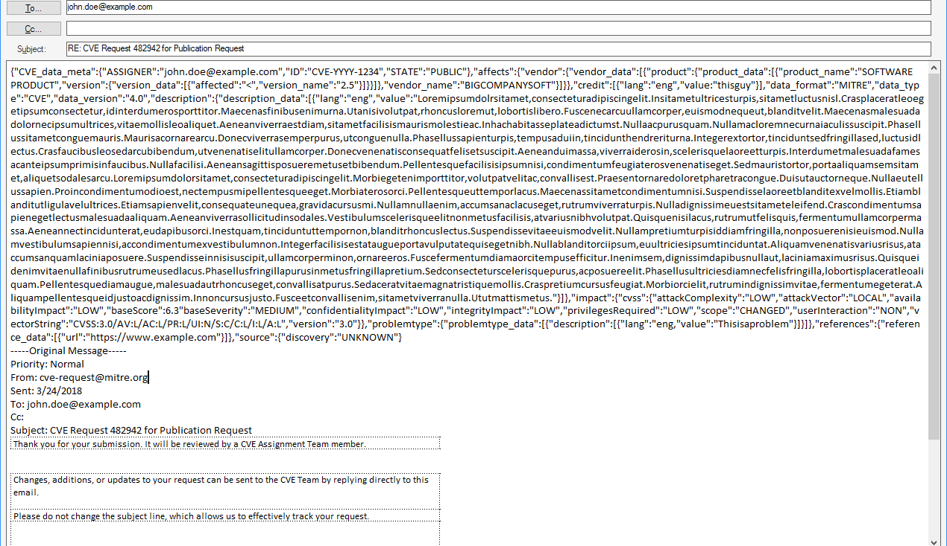
By Replying to the Acknowledgement Email

